Slide 1
Software Presentation
Group 7

Slide 2
Group Dynamics
Each member of the group has suggested ideas and improvements throughout the ongoing weeks.
Luke – Set up Github platform, Pair programming logs, programmed artefact, Product backlog
Darius – Pair programming logs, Programmed artefact, Class Diagram, Product backlog
Hayden – Pair programming logs, Programmed artefact
Savannah – Product backlog, sprint planning, sprint backlog, user stories
presentation
Caitlin – Product backlog, sprint planning, sprint backlog, user stories
Jackson – UI, Pair Programming logs, Product backlog

Slide 3
User Stories
“A user story is a very high-level definition of a requirement, containing just enough information so that the developers can produce a reasonable estimate of the effort to implement it.”
As a < type of user >, I want < some goal > so that < some reason >.
As a user I want to authorise my account without any errors so that I can access Spotify’s news related playlists.
As a user I want to read the article related to the song on the playlist
As a user I want a user friendly, easy and efficient GUI so that my experience is pleasant and enjoyable.
As a user I want to be able to download my news related playlist to listen offline

Slide 4
Completing 1st Sprint
We started the users stories, but due to difference of opinions this was then delegated into pairs.
We then designated different roles to each member of the group to complete within a certain time frame. This included: programming and research into API’s.
We arranged the items for the product backlog by story points and priority.

Slide 5
Product Backlog
ID | Product Backlog Item | User Story | Sprint Points | Priority
1 | Authorise Spotify application. | As a user I want to authorise my account without any errors so that I can access Spotify’s news related playlists. | 20 | 1
2 | News API – Reading news articles. | As a user I want to be able to read current articles. | 5 | 2
3 | Creating the playlist. | Create a playlist that’s relating the new headlines of the day. | 15 | 3
4 | Intuitive user interface. | As a user I would like a user friendly, easy and efficient GUI so that my experience is pleasant and enjoyable. | 10 | 4
5 | Saving the playlist to Spotify account. | As a user I would like to be able to save the playlist to my Spotify account for future use. | 25 | 5
6 | Downloading the Spotify playlist. | As a user I would like to be able to download my news related playlist to listen offline. | 25 | 6
The product backlog uses the user story syntax to produce the backlog items. The product backlog also helps to prioritise the tasks, ensuring that the most important tasks are completed first.
Sprint points – Fibonacci scale
Feature required for Spotify
Product backlog placed in correct sequence – Value/Cost/Knowledge/Risk

Slide 6
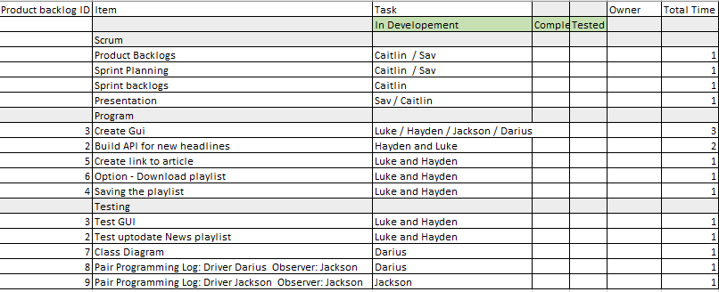
Sprint Backlog
The sprint backlog is simply the list of tasks that relate to the user stories which need to be completed through the Scrum sprint.

Slide 7
Sprint Planning
Product Backlog ID | Product – To do | Outcome – What to Achieve
1 | As a user I want to authorise my account without any errors so that I can access Spotify’s news related playlists. | For the user to be-able to log in to their account with having any errors For the user to be able to sign up
2 | Create a playlist that’s relating the new headlines of the day | Program Spotify to create daily playlist relating the news headlines
3 | As a user I would like a user friendly, easy and efficient GUI so that my experience is pleasant and enjoyable. | To create a UI that the clients can use which is efficient and is user friendly.
4 | Saving the playlist to the users account | For the clients to be able to save the playlist to their individual user account.
5 | As a user I want to read the article related to the song on the playlist | Program Spotify to be able to give you the link to be able to read an article relating the headlines
6 | As a user I would like to be able to download my news related playlist to listen offline | To program Spotify making sure the clients/ customers able to download the playlist
Sprint Planning is the subset of the product backlog. During sprint planning the team have agreed on a sprint goal.
Sprint planning is about what objectives we have and want the outcome will be.

Slide 8
Pair Programming Log: Driver: Darius Observer: Jackson
Time session started | Number of lines of code written | Errors spotted (and by whom) | Activity (what’s being coded), or tested, or compiled | Comments | Fixed error
29/10/2019 | Line: 24 | 1 | MessageBox.Show(“Please input the user name”) | Add speech marks to the text. | Yes
29/10/2019 | Line: 24 Line: 37 | 2 | this.Close(); | Add brackets at the end of the “this.Close()”; When selecting Log in button displays message instead of going to the next login form. | Yes Yes
29/10/2019 | N/A | 0 | Sign in button moves to next form | N/A | N/A

Slide 9
Pair Programming Log: Driver: Jackson Observer: Darius
Time session started | Number of lines of code written | Errors spotted (and by whom) | Activity (what’s being coded), or tested, or compiled | Comments
29/10/2019 | 41 | 1 | Choose the function | Use the Break for every cases
29/10/2019 | 58 | 3 | Update playlist | Remember to press; at the end of codes

Slide 10
Pair Programming Log: Driver: Luke Observer: Darius
Time session started | Number of lines of code written | Errors spotted (and by whom) | Activity (what’s being coded), or tested, or compiled | Comments
31/10/2019 1:30pm – 3:00pm | 55 Lines of code (Newspanel class) | Some invalid arguments when adding news articles. Darius has spotted the errors | Coding news articles for the user interface | N/A

Slide 11
Pair Programming Log: Driver: Luke Observer: Hayden
Time session started | Number of lines of code written | Errors spotted (and by whom) | Activity (what’s being coded), or tested, or compiled | Comments
30/10/2019 2:15pm-4:15pm | 30 lines of codes | HTTP errors. Luke has spotted the errors. | Coded the API to work with the application as well as experimenting with it. | Used this library https://newsapi.org/ to write our code for the news API

Slide 12
Pair Programming Log: Driver: HAYDEN Observer: luke
Time session started | Number of lines of code written | Errors spotted (and by whom) | Activity (what’s being coded), or tested, or compiled | Comments
30/10/2019 4:15pm – 5:15pm | 3 lines of code | No errors | A search using the Spotify API. By querying random search parameters. | Used this library https://johnnycrazy.github.io/SpotifyAPI-NET/ to write our code for the Spotify API

Slide 13
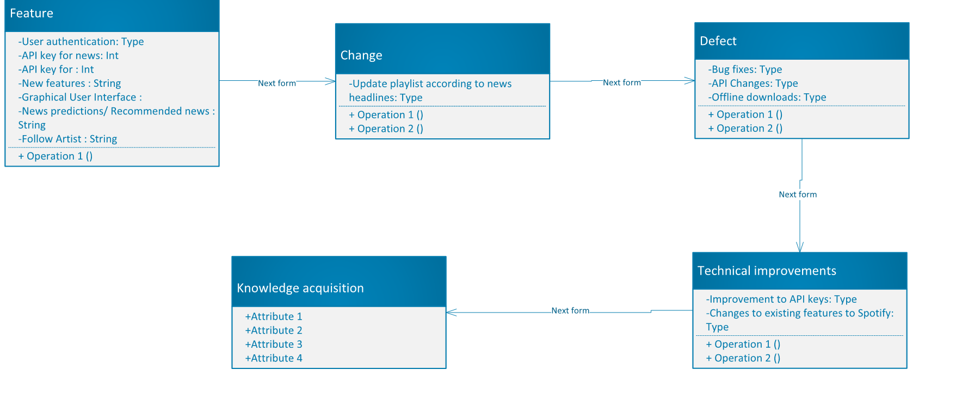
Class Diagram

Slide 14
Tools and Toolsets
As a group, we have used the GitHub platform to upload pieces of work which contributes to the overall assignment.
We have also used Draw.io to create any diagrams required throughout.
Visual studio Windows forms Framework
Used Spotify-NET API Libraries (SpotifyAPI.Web, SpotifyAPI.Web.Auth, SpotifyAPI.Web.Models): website used https://johnnycrazy.github.io/SpotifyAPI-NET/
Used News API: website used https://newsapi.org/

Slide 15
Evaluation
The tasks where delegated by Hayden, which where then completed by each member within a time frame. The group assisted each other with their tasks if help was required.
Our expectations for this project is to ensure it is completed on time and each member has sufficiently contributed.
Advantages – Sets out a overview of what needs to be done with a set time frame.
Disadvantages – Unknown elements needed for the program. Not knowing the total time needed to complete each task.

Slide 16
Thank you

